Slide 1
Did you know you could do this in Self Service?
Presented by:
Erica King
IRT TIS
kinge@rowan.edu

Slide 2
Topics Covered
Creating a template for Requisitions and Budget Queries
Pending Documents
How to complete an unprocessed Requisition
View Documents

Slide 3
Topics Covered
Creating a template for Requisitions and Budget Queries
Calculated Column
Pending Documents
How to complete an unprocessed Requisition
Viewing all purchase orders for a FOPAL
View Documents

Slide 4
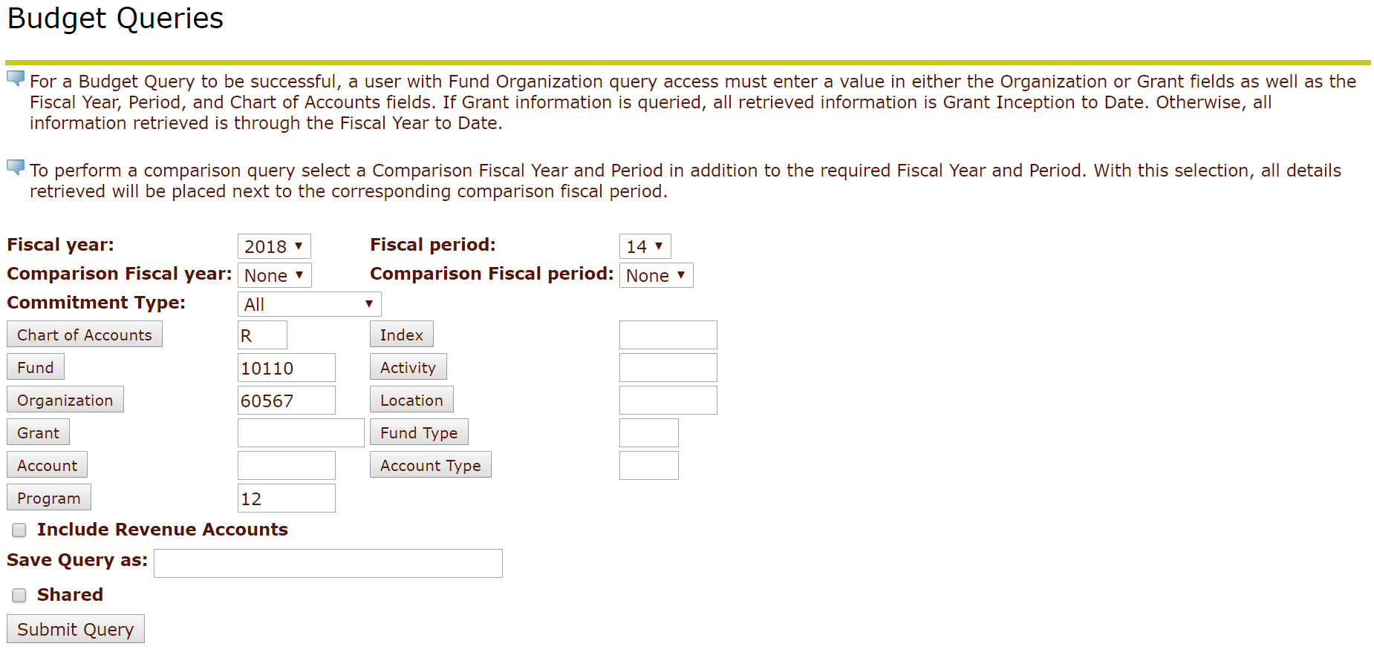
Create a Template for Requisitions & Budget Queries
Notes:
Fund 10110 Org 22004 For IRT in Training

Slide 5
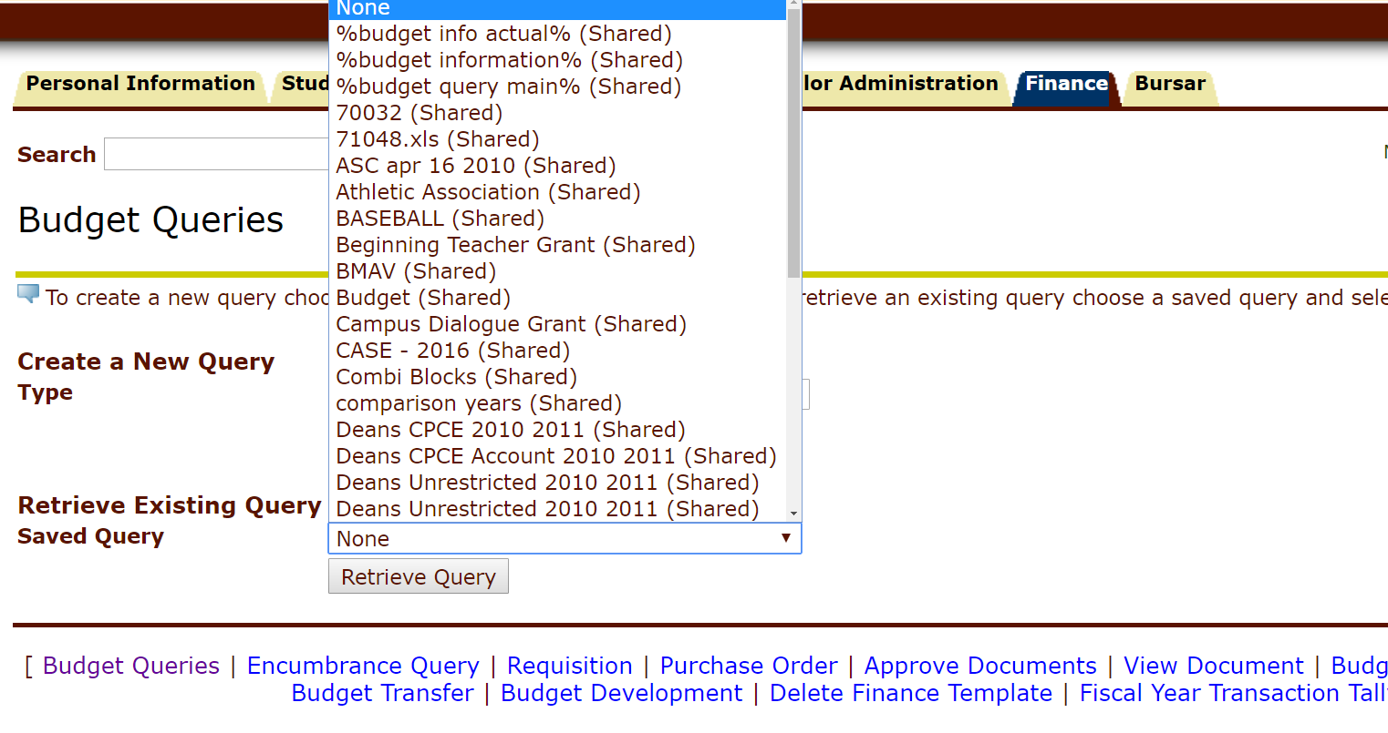
Create a Template for Requisitions & Budget Queries
Once a requisition or budget has been created it can be retrieved and reused again

Slide 6
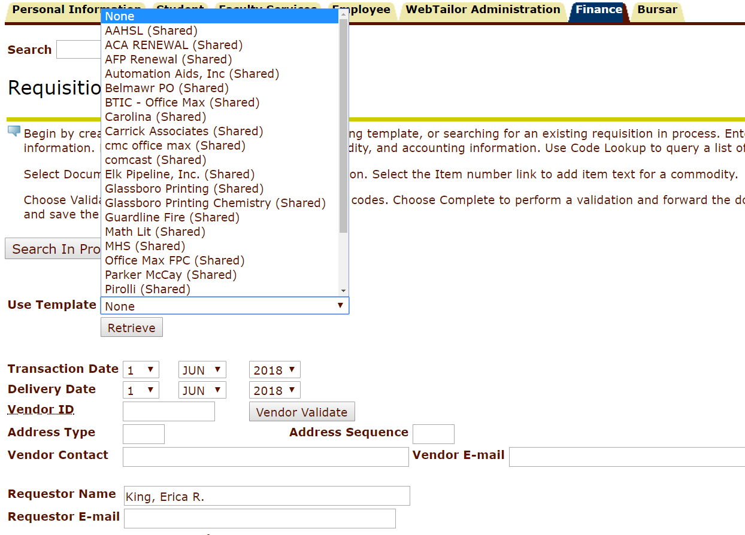
Create a Template for Requisitions & Budget Queries
Once a requisition or budget has been created it can be retrieved and reused again

Slide 7
Calculated Column
An additional Calculated Column can be added temporarily to your budget screen to provide more information.
Example: FY18/PD14 Year to Date, Divided By, FY18/PD14 Adjusted Budget, Displayed after FY18/PD14 Available Balance, New Column Description: Percent Spent
This will show the percent of each account spent
Notes:
**** Fund 10110 Org 22004 For IRT in Training

Slide 8
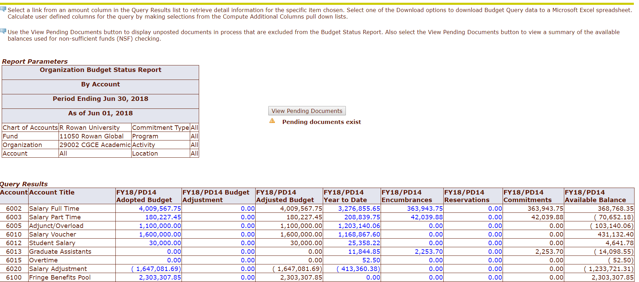
Pending Documents
Notes:
Fund 11050 Org 29002 For Rowan Global in Training Instance

Slide 9
Pending Documents
There are many reasons why a document might be pending:
Items not received, issues with transactions, new requisitions that have not be converted to a PO yet.

Slide 10
Pending Documents
If you need to find the documents associated with an Invoice, FOIDOCH in Banner 9 Administrative Pages is the best way. You can use the document type “INV” and the Invoice number as the document code. Please attend a FOIDOCH class to explore this.

Slide 11
Completing an unprocessed requisition
If you need to fix a requisition, visit the Search for In Process Requisitions option on the requisition screen. Execute query on the Document Lookup Screen.

Slide 12
Completing an unprocessed requisition
Any in process documents will appear. Select the requisition number. The requisition will appear and the necessary changes can be made. When done, hit Complete.

Slide 13
View Documents
There are many reasons why you might use View Documents.
Taking over a position and you need to know what the previous person was doing in Banner.
Which vendor did we use for a past item?
What commodity code was used when a certain requisition was placed?
Notes:
**** HEGEL

Slide 14
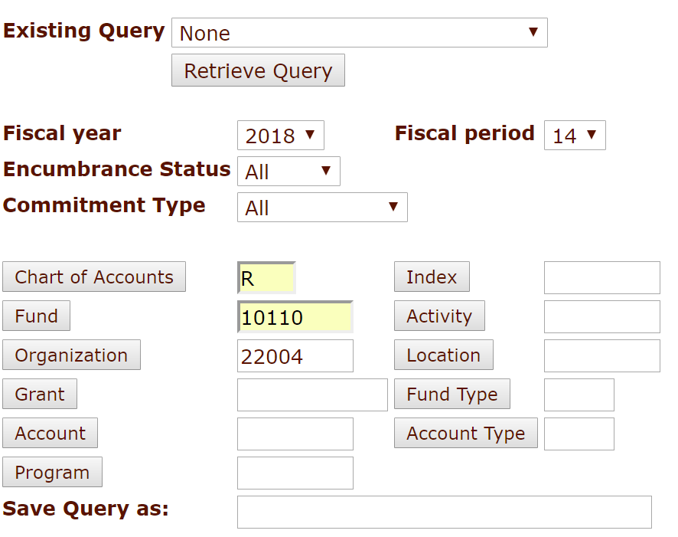
View all purchase orders for a FOPAL
If you would like to see all purchase orders for a given FOPAL you can go to Encumbrance Query and look up all encumbrances instead of open encumbrances.

Slide 15
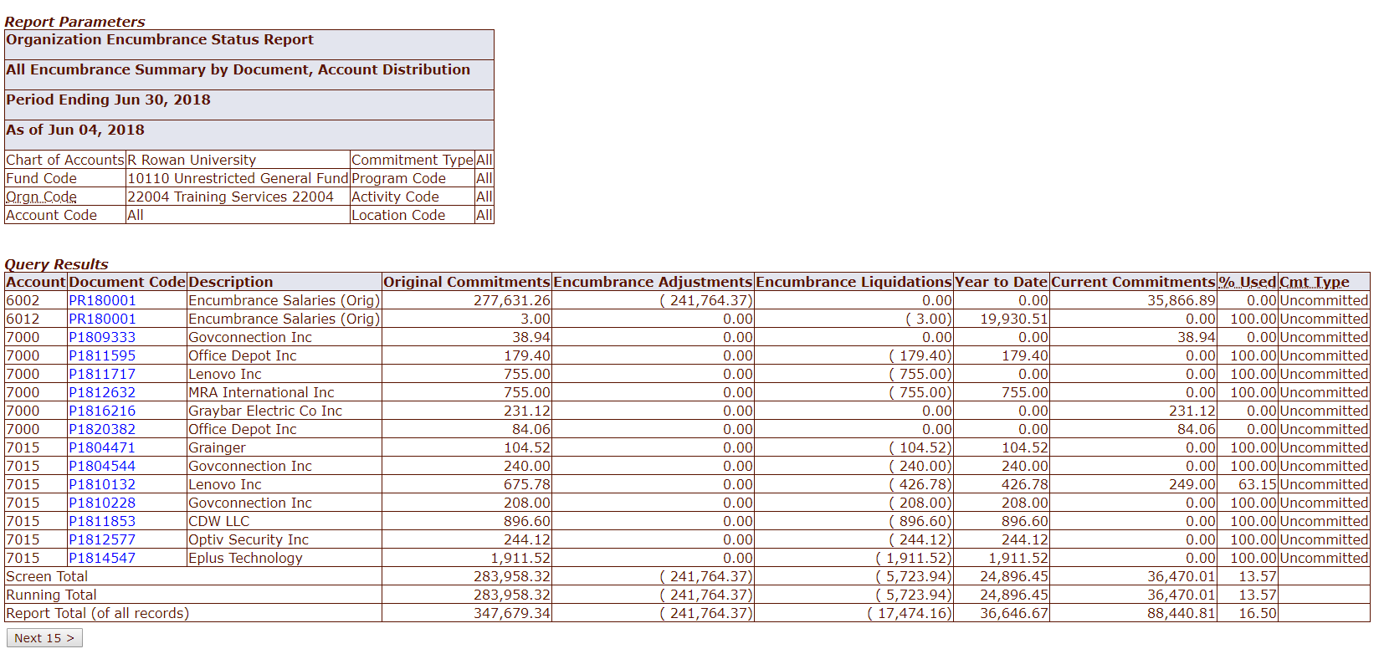
View all purchase orders for a FOPAL

Slide 16
What Do You Know?
Respond at
PollEv.com/ericaking076
A, B or C to Respond

Slide 17
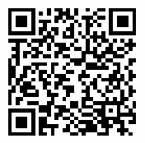
Survey Time
We appreciate your feedback!
Please view this QR code in the camera on your phone and then open the survey from the top of the screen. Please complete the survey or go to this link from your smart phone:
https://tinyurl.com/finfy18

