Slide 1
Banner 9 Admin Pages RECEIVING
Presented by:
Lucille Pippetti
Accounts Payable
pippetti@rowan.edu
Jennifer Savage
IRT TIS
savagej@rowan.edu

Slide 2
What Do You Know Already?
Respond at PollEv.com/jennifersava139 or TEXT JENNIFERSAVA139 to 22333 to join
A, B or C to Respond

Slide 3
3 Types of Receiving in Banner 9 Admin Pages
Complete Regular Order: Physically receive all items at once
Partial Regular Order: Receive some items in the order
Standing Order: Receive dollar amount

Slide 4
Banner 9 Admin Pages -- Receiving
Receiving Goods - FPARCVD
Why NEXT?
What do I enter if I receive multiple times on a PO?

Slide 5
Banner 9 Admin Pages -- Receiving
Receiving Header – Next Section
Purchase Order – PO #
Packing Slip – Invoice, Packing Slip or Initials/Date

Slide 6
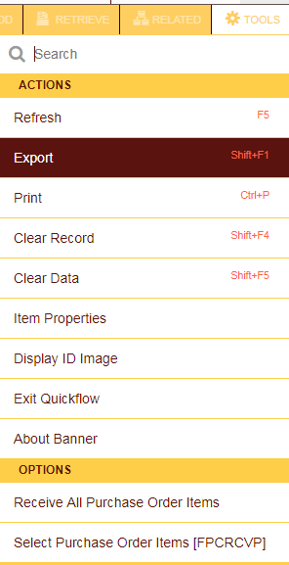
Banner 9 Admin Pages -- Receiving
Tools Menu
What type of receiving?
Complete Regular
Receive All PO Items

Slide 7
Banner 9 Admin Pages -- Receiving
Receive All PO Items
Complete

Slide 8
Banner 9 Admin Pages -- Receiving

Slide 9
Banner 9 Admin Pages -- Receiving
Tools Menu
What type of receiving?
Partial Regular
Select PO Items

Slide 10
Banner 9 Admin Pages -- Receiving
Select PO Items
Save and Close

Slide 11
Banner 9 Admin Pages -- Receiving
Select 1st item
Enter Amount in Current field
Repeat as Needed
Complete

Slide 12
Banner 9 Admin Pages -- Receiving
Easy…..Peasy?!

Slide 13
Banner 9 Admin Pages -- Receiving
Tools Menu
What type of receiving?
Standing Orders
Select PO Items

Slide 14
Banner 9 Admin Pages -- Receiving
Same as Partial Regular EXCEPT…
Enter DOLLAR Amount in Current field
Complete

Slide 15
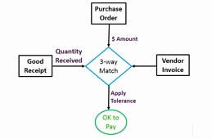
Banner 9 Admin Pages -- Receiving
REGULAR VS STANDING ORDERS
3-way Match vs Workflow

Slide 16
Banner 9 Admin Pages -- Receiving
INCOMPLETE RECEIVING

Slide 17
Banner 9 Admin Pages -- Receiving
Go to FPARCVD
Enter Y Number
Complete or Delete

Slide 18
Banner 9 Admin Pages -- Receiving
Can Purchasing or Accounts Payable delete a completed receiving?

Slide 19
Banner 9 Admin Pages -- Receiving
FOIDOCH IS YOUR FRIEND!!

Slide 20
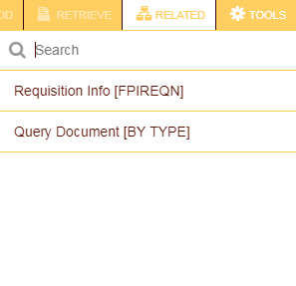
Banner 9 Admin Pages -- Receiving
Document History
Check the Status
Drill Down for More Info
Requisition, PO, Invoice, Check, Receiving

Slide 21
Banner 9 Admin Pages -- Receiving
Select Filter
Enter PO Number in PO Filter Field
FPIPKSL – All receiving for one PO

Slide 22
Banner 9 Admin Pages -- Receiving
FGIENCD – All invoices/credit memos for one PO

Slide 23
Banner 9 Admin Pages -- Receiving
Return and receive when get correct item
Reject and enter Quantity Received in Current Received
Enter Quantity Rejected in Current Rejected
FPARCVD - Returning/Rejecting Items

Slide 24
Banner 9 Admin Pages -- Receiving
BEST PRACTICE
EOY Dates
Nestle Account Numbers

Slide 25
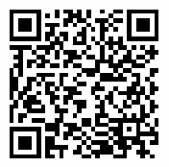
You Are Now an Expert in Receiving!
We appreciate your feedback!
Please view this QR code in the camera on your phone and then open the survey from the top of the screen. Please complete the survey or go to this link from your smart phone: https://tinyurl.com/finfy18

Slide 26
References
Easy Peasy! Brush Lettering Vector Illustration Design Template. By Orange Vectors, Royalty-free stock vector ID: 476700514. https://www.shutterstock.com/image-vector/easy-peasy-brush-lettering-vector-illustration-476700514?src=5SUszWnhx7pp3CzpvYuIUQ-1-15&drawer=open
Tab Key – InforamtionQ.com. https://www.google.com/search?q=picture+of+tab+key&rlz=1C1GGRV_enUS748US748&tbm=isch&source=iu&ictx=1&fir=GL6OzNznCXlC7M%253A%252C2GqSBGNnPh0WFM%252C_&usg=__czjBIokfSmyXSkGCNPYnz8KCHDA%3D&sa=X&ved=0ahUKEwiGgqnk1LrbAhVOzVMKHe7CCGoQ9QEILTAB#imgrc=GL6OzNznCXlC7M:
Difficult Images – Pixabay. https://pixabay.com/en/photos/difficult/
3 Way Invoice Matching Images Invoice tolerance Keys – An Insight – Part 1. https://www.google.com/search?q=free+picture+of+3+way+match&rlz=1C1GGRV_enUS748US748&tbm=isch&tbo=u&source=univ&sa=X&ved=0ahUKEwjdwYe8hbPbAhXCyVMKHdhmBAsQsAQIOA&biw=1920&bih=989#imgrc=cU0bfVA1FR8uGM:
Incomplete red vintage rubber stamp isolated on white background. https://www.google.com/search?rlz=1C1GGRV_enUS748US748&biw=1920&bih=989&tbm=isch&sa=1&ei=gYkRW4OCMJLuzgKZ3bbgDw&q=free+picture+of+incomplete&oq=free+picture+of+incomplete&gs_l=img.3..35i39k1.7606.10036.0.10228.13.12.1.0.0.0.77.675.12.12.0....0...1c.1.64.img..0.12.626...0j0i8i30k1j0i24k1.0.zUipO9U2_9Y#imgrc=T3-ghtQIHSwn3M:
Friends Clip Art Black and White. https://www.google.com/search?rlz=1C1GGRV_enUS748US748&biw=1920&bih=989&tbm=isch&sa=1&ei=lIwRW6HHI4eTzwLV0ZKoCg&q=free+picture+of+FRIEND&oq=free+picture+of+FRIEND&gs_l=img.3...942559.943197.0.943421.6.6.0.0.0.0.103.396.5j1.6.0....0...1c.1.64.img..0.2.111...0j0i30k1j0i8i30k1j0i24k1.0.R71KSpS6JkU#imgrc=Up-mrNauPuwdcM:
Best Practice Concept on Blackboard. By bleakstar. https://www.shutterstock.com/image-photo/best-practice-concept-on-blackboard-233225104?src=bWOdLmXwwi-XW9ECq--GDA-1-0

